Slide 1
Basic Electrical and Electronics Engineering
LECTURE 3.4
Dr. Sonam Shrivastava/ Assistant Professor (Sr.) /SELECT

Slide 2
BEEE102L
Basic Electrical and Electronics Engineering
DC Circuits
AC Circuits
Magnetic Circuits
Electrical Machines
Semiconductor Devices and Applications
Digital Systems

Slide 3
Books
Text Books
Allan R. Hambley, “Electrical Engineering -Principles & Applications”, 2019, 6th Edition, Pearson Education
V. D. Toro, Electrical Engineering Fundamentals, 2nd edition. PHI, 2014
Reference Books
R. L. Boylestad and L. Nashelsky, Electronic Devices and Circuit Theory, 11th edition. Pearson, 2012
DP Kothari & Nagrath, “Basic Electric Engineering”, 2019, Tata McGraw Hill

Slide 4
Module 3. Magnetic Circuits
Electromagnetic Induction: Self And Mutual
Magnetically Coupled Circuits
Series and Parallel Magnetic Circuits
Dot Convention

Slide 5
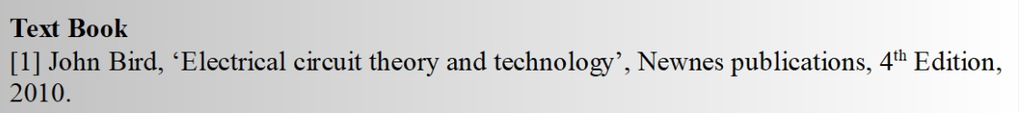
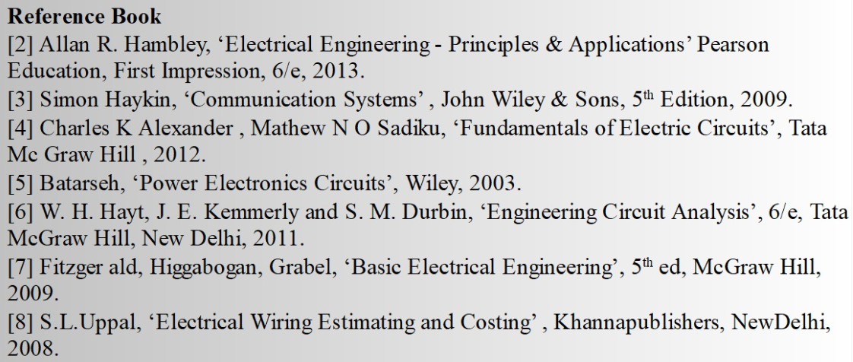
Books

Slide 6
Module 3. Magnetic Circuits
Electromagnetic Induction: Self And Mutual
Magnetically Coupled Circuits
Series and Parallel Magnetic Circuits
Dot Convention

Slide 7
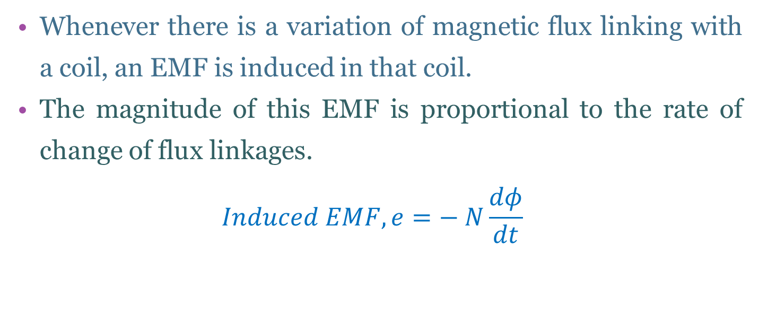
Faradays Law :
Whenever there is a variation of magnetic flux linking with a coil, an EMF is induced in that coil.
The magnitude of this EMF is proportional to the rate of change of flux linkages.
$$Induced EMF, e=− N\frac{dφ}{dt}$$

Slide 8
Lenz’s Law:
Lenz’s law states that the induced EMF in a coil will induce a current whose direction is such that it opposes the cause producing the EMF.

Slide 9
Magnetically coupled Circuits
The circuits we have considered so far may be regarded as conductively coupled, because one loop affects the neighboring loop through current conduction.
When two loops with or without contacts between them affect each other through the magnetic field generated by one of them, they are said to be magnetically coupled.
The transformer is an electrical device designed on the basis of the concept of magnetic coupling.
It uses magnetically coupled coils to transfer energy from one circuit to another. They are used in power systems for stepping up or stepping down ac voltages or currents.
They are used in electronic circuits such as radio and television receivers for such purposes as impedance matching, isolating one part of a circuit from another, and again for stepping up or down ac voltages and currents.

Slide 10
What is Magnetic Induction?
Magnetic Induction is the emf produced across a electric conductor which is proportional to the rate of change of the magnetic field.
L is used to represent the inductance and Henry is the SI unit of inductance.
Factors Affecting Inductance
The number of turns of the wire used in the inductor.
The material used in the core.
The shape of the core.

Slide 11
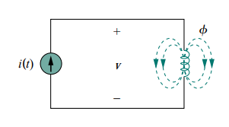
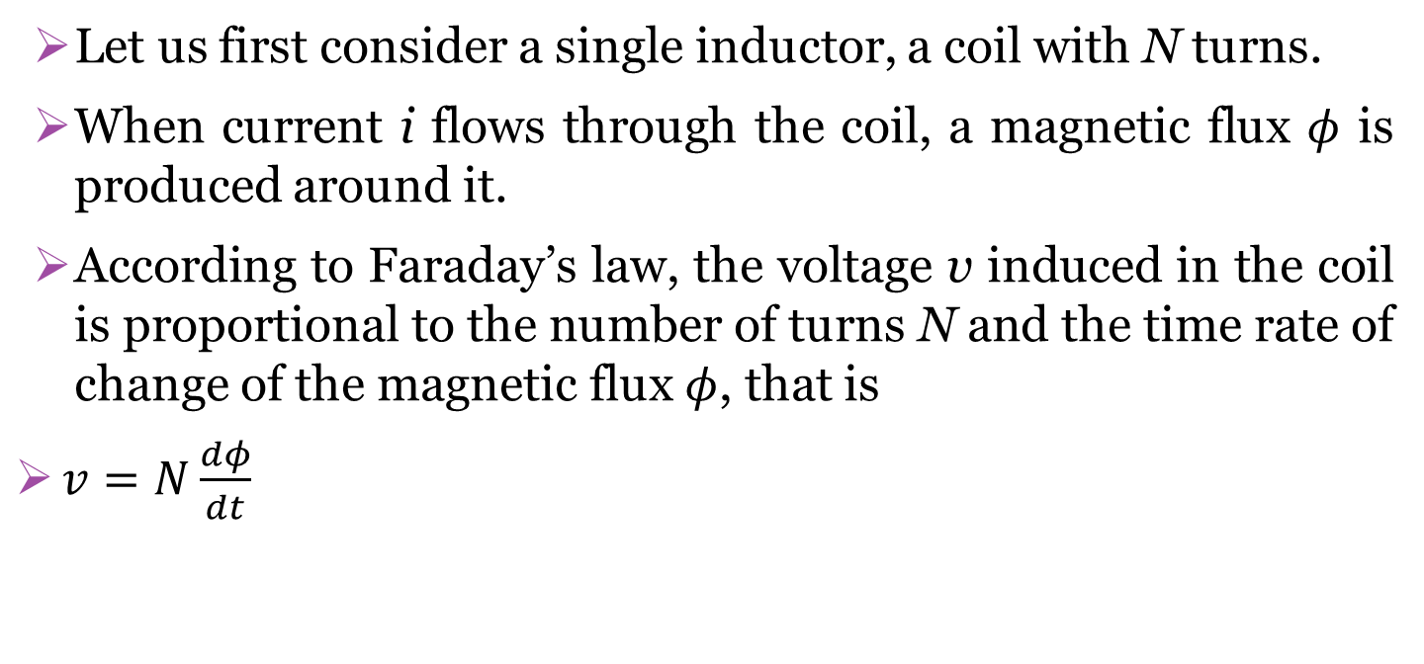
Self inductance
Let us first consider a single inductor, a coil with N turns.
When current i flows through the coil, a magnetic flux $φ$ is produced around it.
According to Faraday’s law, the voltage v induced in the coil is proportional to the number of turns N and the time rate of change of the magnetic flux $φ$, that is
$v=N\frac{dφ}{dt}$

Slide 12
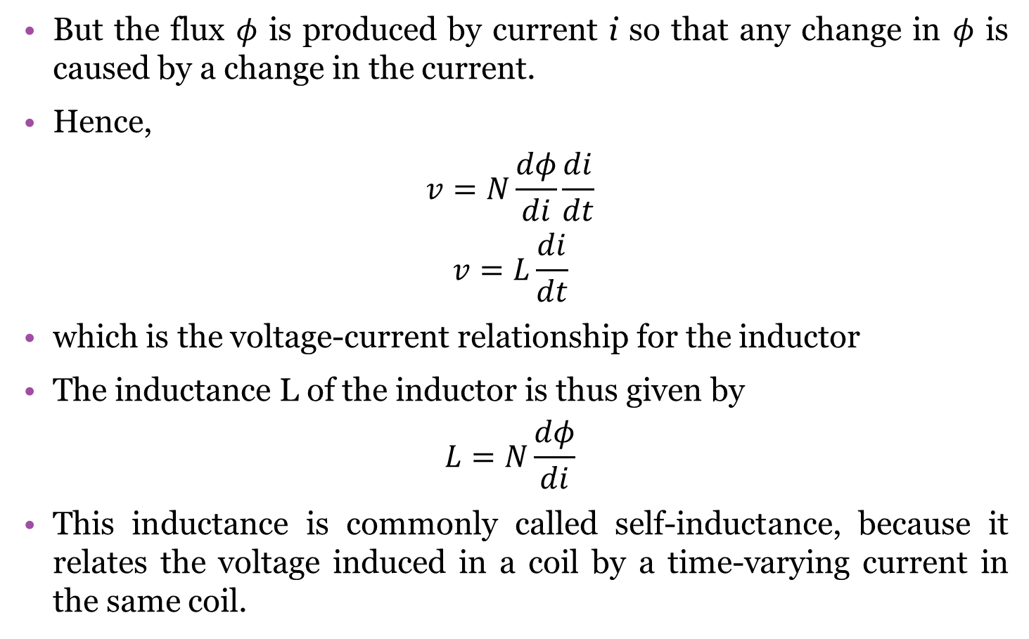
Self inductance
But the flux $φ$ is produced by current i so that any change in $φ$ is caused by a change in the current.
Hence,
$$v=N\frac{dφ}{di}\frac{di}{dt}$$
$$v=L\frac{di}{dt}$$
which is the voltage-current relationship for the inductor
The inductance L of the inductor is thus given by
$$L=N\frac{dφ}{di}$$
This inductance is commonly called self-inductance, because it relates the voltage induced in a coil by a time-varying current in the same coil.

Slide 13
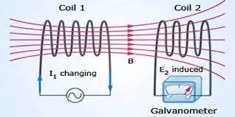
Mutual inductance
When two inductors (or coils) are in a close proximity to each other, the magnetic flux caused by current in one coil links with the other coil, thereby inducing voltage in the later.
This phenomenon is known as mutual inductance.

Slide 14
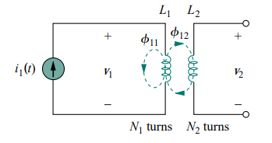
Mutual inductance
Now consider two coils with self-inductances L1 and L2 that are in close proximity with each other.
Coil 1 has N1 turns, while coil 2 has N2 turns.
The magnetic flux φ1 emanating from coil 1 has two components: one component φ11 links only coil 1, and another component φ12 links both coils.
Hence,
φ1 = φ11 + φ12
ϕ12​→ magnetic flux in coil 2 due to current I1.

Slide 15
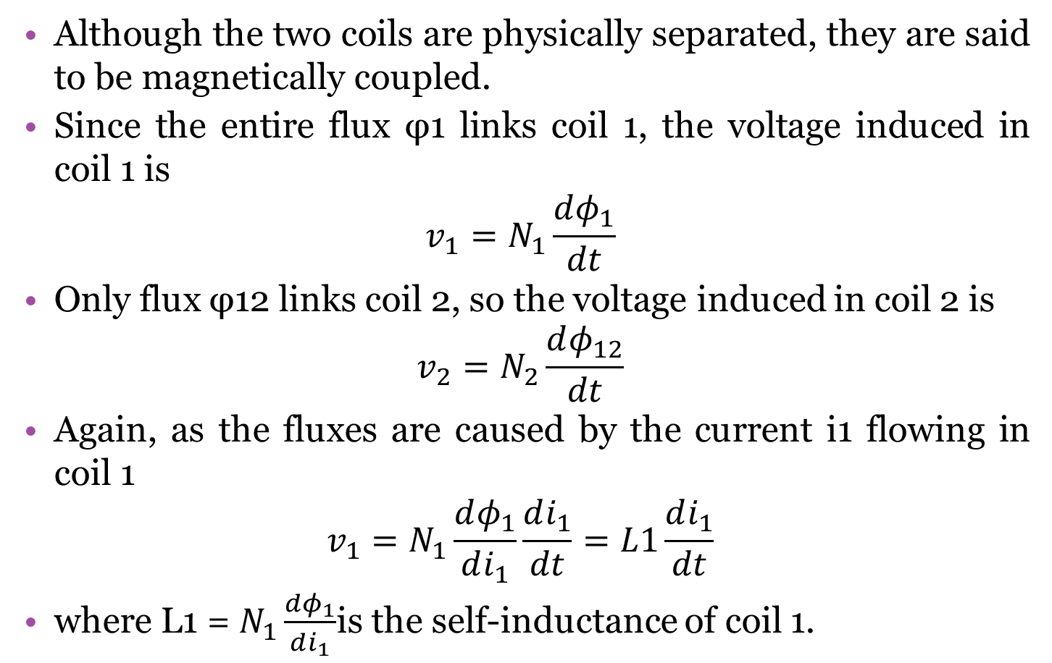
Mutual inductance
Although the two coils are physically separated, they are said to be magnetically coupled.
Since the entire flux φ1 links coil 1, the voltage induced in coil 1 is
$$v_{1}=N_{1}\frac{dφ_{1}}{dt}$$
Only flux φ12 links coil 2, so the voltage induced in coil 2 is
$$v_{2}=N_{2}\frac{dφ_{12}}{dt}$$
Again, as the fluxes are caused by the current i1 flowing in coil 1
$$v_{1}=N_{1}\frac{dφ_{1}}{di_{1}}\frac{di_{1}}{dt}=L1\frac{di_{1}}{dt}$$
where L1 = $N_{1}\frac{dφ_{1}}{di_{1}}$is the self-inductance of coil 1.

Slide 16
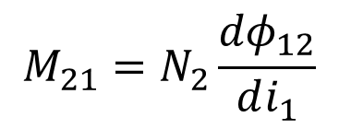
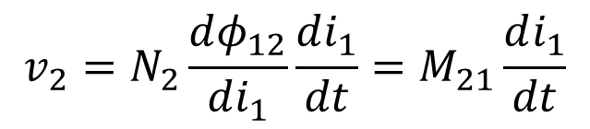
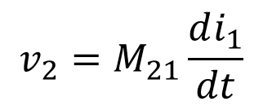
Mutual inductance
Similarly,
$$v_{2}=N_{2}\frac{dφ_{12}}{di_{1}}\frac{di_{1}}{dt}=M_{21}\frac{di_{1}}{dt}$$
$$M_{21}=N_{2}\frac{{dφ}_{12}}{di_{1}}$$
M21 is known as the mutual inductance of coil 2 with respect to coil 1
Subscript 21 indicates that the inductance M21 relates the voltage induced in coil 2 to due to the current in coil 1.
Thus, the open-circuit mutual voltage (or induced voltage) across coil 2 is
$$v_{2}=M_{21}\frac{di_{1}}{dt}$$

Slide 17
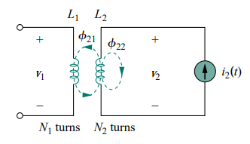
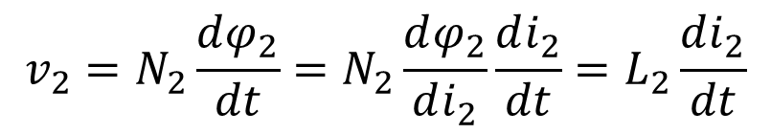
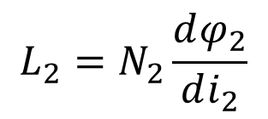
Mutual inductance
Suppose we now let current i2 flow in coil 2, while coil 1 carries no current
The magnetic flux φ2 emanating from coil 2 comprises flux φ22 that links only coil 2 and flux φ21 that links both coils.
φ2 = φ21 + φ22
The entire flux φ2 links coil 2, so the voltage induced in coil 2 is
$$v_{2}=N_{2}\frac{dφ_{2}}{dt}=N_{2}\frac{dφ_{2}}{di_{2}}\frac{di_{2}}{dt}=L_{2}\frac{di_{2}}{dt}$$
$$L_{2}=N_{2}\frac{dφ_{2}}{di_{2}}$$

Slide 18


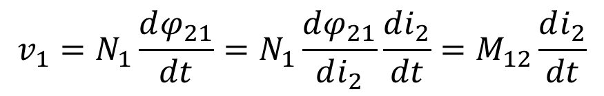
Mutual inductance
where$L_{2}=N_{2}\frac{dφ_{2}}{di_{2}}$is the self-inductance of coil 2.
Since only flux φ21 links coil 1, the voltage induced in coil 1 is
Where
$$M_{12}=N_{1}\frac{dφ_{21}}{di_{2}}$$
$$v_{1}=N_{1}\frac{dφ_{21}}{dt}=N_{1}\frac{dφ_{21}}{di_{2}}\frac{di_{2}}{dt}=M_{12}\frac{di_{2}}{dt}$$
which is the mutual inductance of coil 1 with respect to coil 2. Thus, the open-circuit mutual voltage across coil 1 is

Slide 19


Mutual inductance
In practical coupled coils,
${φ_{12}=φ}_{21}=$ $φ$
So we can write
${M_{12}=M}_{21}=$ $M$
Where M is mutual inductance

Slide 20
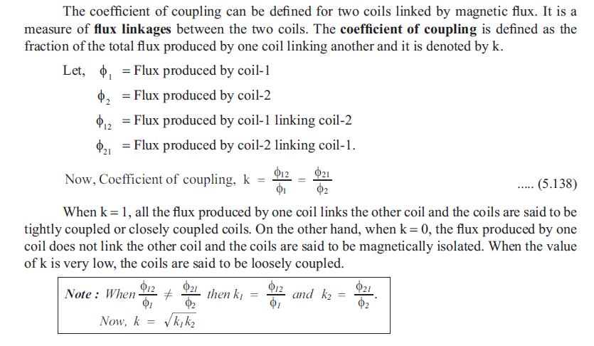
Co-efficient of Coupling

Slide 21
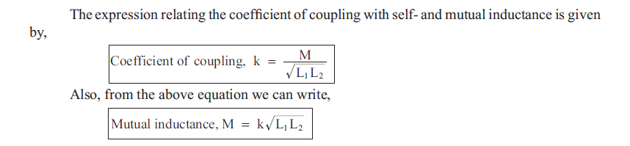
Co-efficient of Coupling

Slide 22
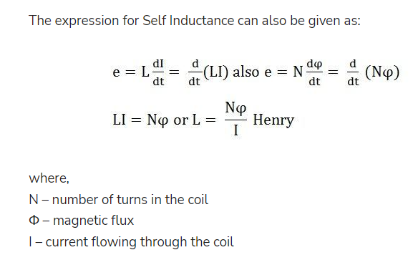
Expression for self inductance (L)

Slide 23
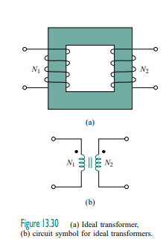



TURNS RATIO FOR TRANSFORMER n
For ideal transformer no losses hence

Slide 24
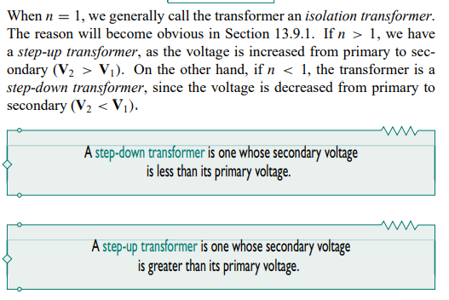

Slide 25
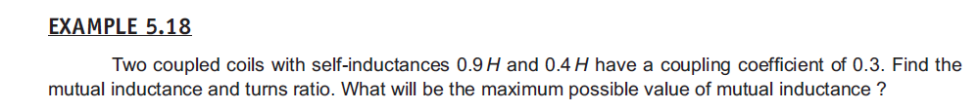
Question

Slide 26
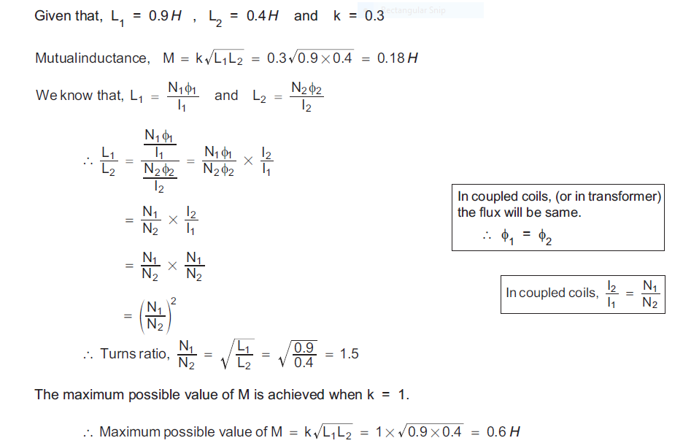
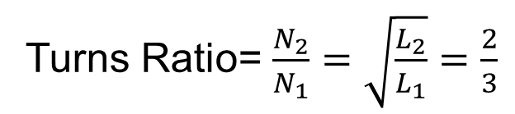
Question
Turns Ratio= $\frac{N_{2}}{N_{1}}=\sqrt{\frac{L_{2}}{L_{1}}}=\frac{2}{3}$

Slide 27
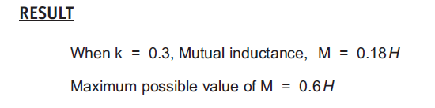
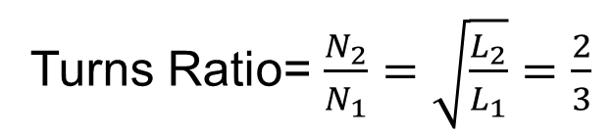
Turns Ratio= $\frac{N_{2}}{N_{1}}=\sqrt{\frac{L_{2}}{L_{1}}}=\frac{2}{3}$

Slide 28
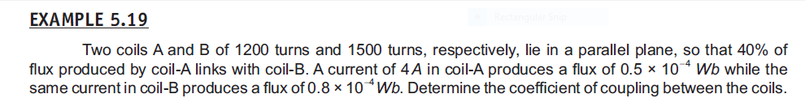
Question

Slide 29
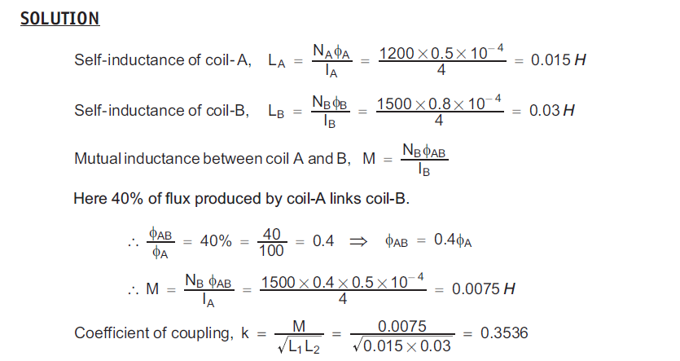
Question

